Slide 1
Graphically solving two linear graphs that intersect
Graphical representations

Slide 2
How our teaching resources are designed for the classroom

Slide 3
I can recognise that the point of intersection of two linear graphs satisfies both relationships and hence represents the solution to both those equations.

Slide 4
The relationship between two variables is linear if, when plotted on a pair of axes, a straight line is formed.

Slide 5

Graphically solving two linear graphs that intersect
Points of intersection
Regions of a graph

Slide 6
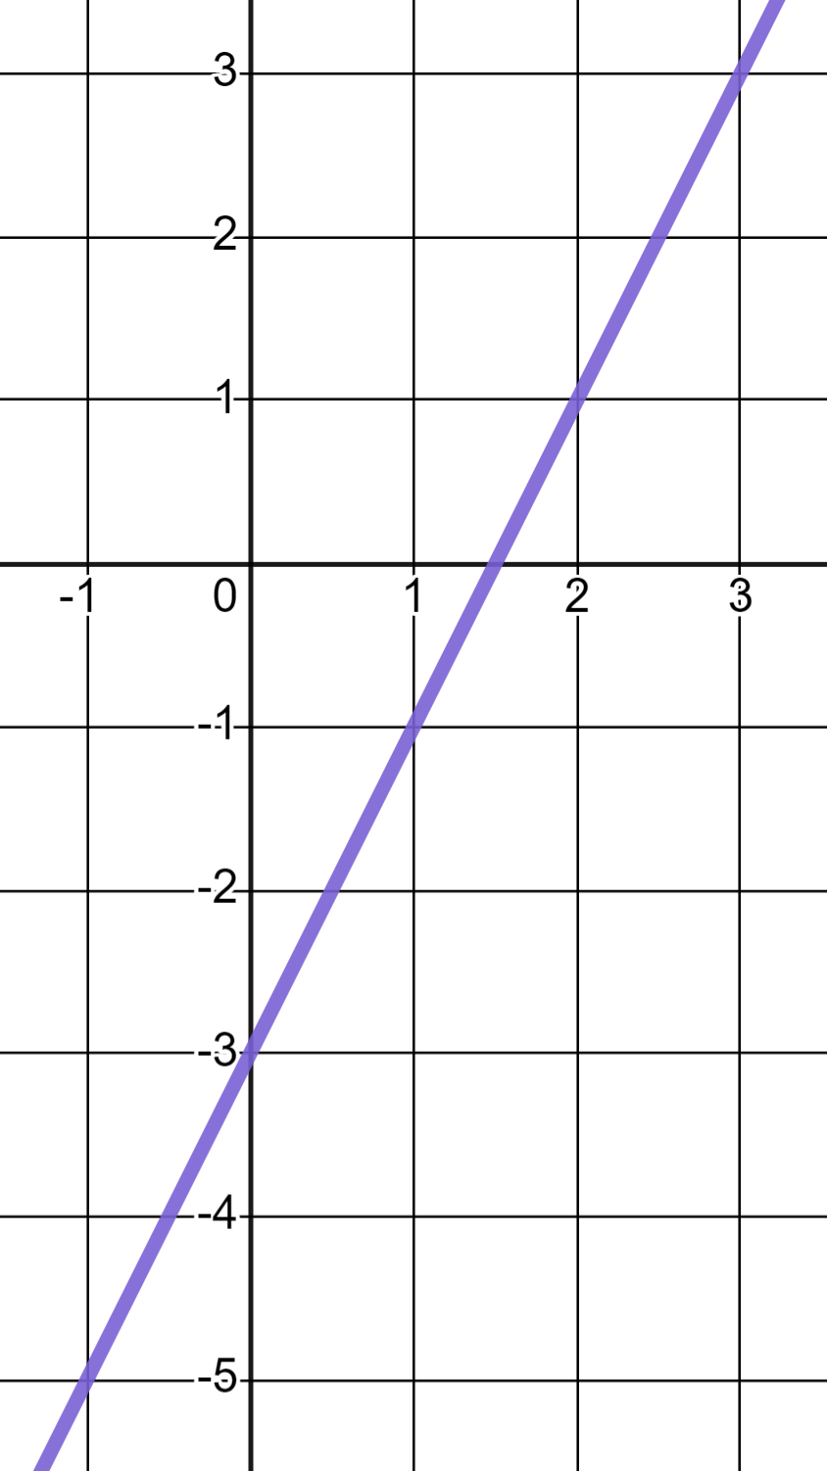
Points of intersection
We can draw the graphs of linear equations by calculating coordinates and plotting, or by using technology.
y
For example, the linear equation y = 2x − 3
x

Slide 7

Points of intersection
Every coordinate on this line satisfies the equation y = 2x − 3
y
✖
(3, 3)
(3, 3)
(3) = 2(3) − 3
✖
(2, 1)
(2, 1)
(1) = 2(2) − 3
x
✖
(1,−1)
(1,−1)
(−1) = 2(1) − 3
(0,−3)
(−3) = 2(0) − 3
✖
(0,−3)

Slide 8
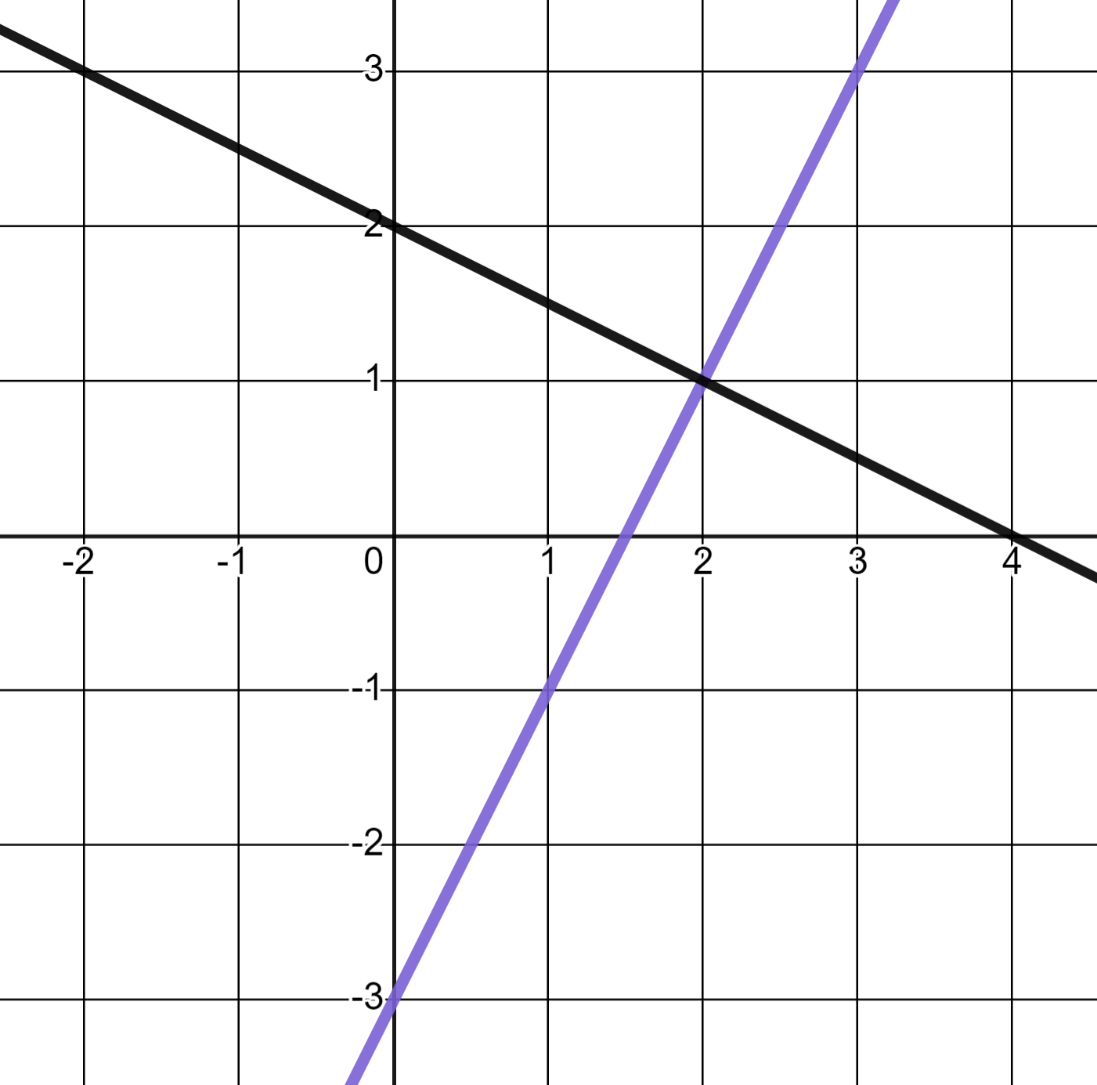
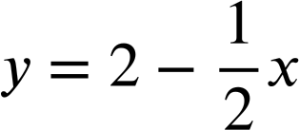
Points of intersection
When we plot two linear equations with different gradients we get an intersection.
y
The linear equation y = 2x − 3
and the linear equation
x
The intersection is the point where the two lines cross.

Slide 9
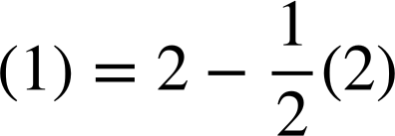
Points of intersection
The point of the intersection is unique in that it is the only point which satisfies both equations.
y
y = 2x − 3
(2, 1)
(1) = 2(2) − 3
(2, 1)
✖
x
(2, 1)

Slide 10

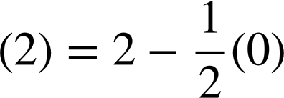
Points of intersection
No other point has this property.
Only one equation is satisfied.
y
y = 2x − 3
✖
(0, 2)
(0, 2)
(2) = 2(0) − 3
x
(0, 2)

Slide 11
Points of intersection
It is only the coordinates of the point of intersection which will satisfy both equations.
y
y = 2x − 3
(2, 1)
(1) = 2(2) − 3
(2, 1)
✖
x
(2, 1)

Slide 12
Points of intersection
The point at the intersection of two linear graphs will satisfy just one of the equations.
Every point on a given line will satisfy that one equation.
The point at the intersection is unique in that it is the only point which satisfies both equations.

Slide 13
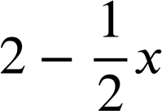
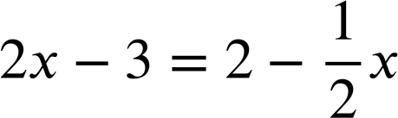
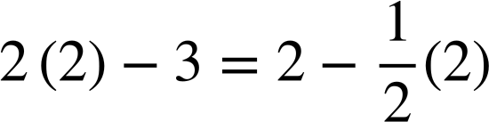
Points of intersection
The intersection gives us other information.
It is the moment when the lines of 2x − 3 and meet therefore it is the solution to the equation
y
✖
(2, 1)
x
An x input of 2 makes both equations equal therefore x = 2 is the solution.

Slide 14
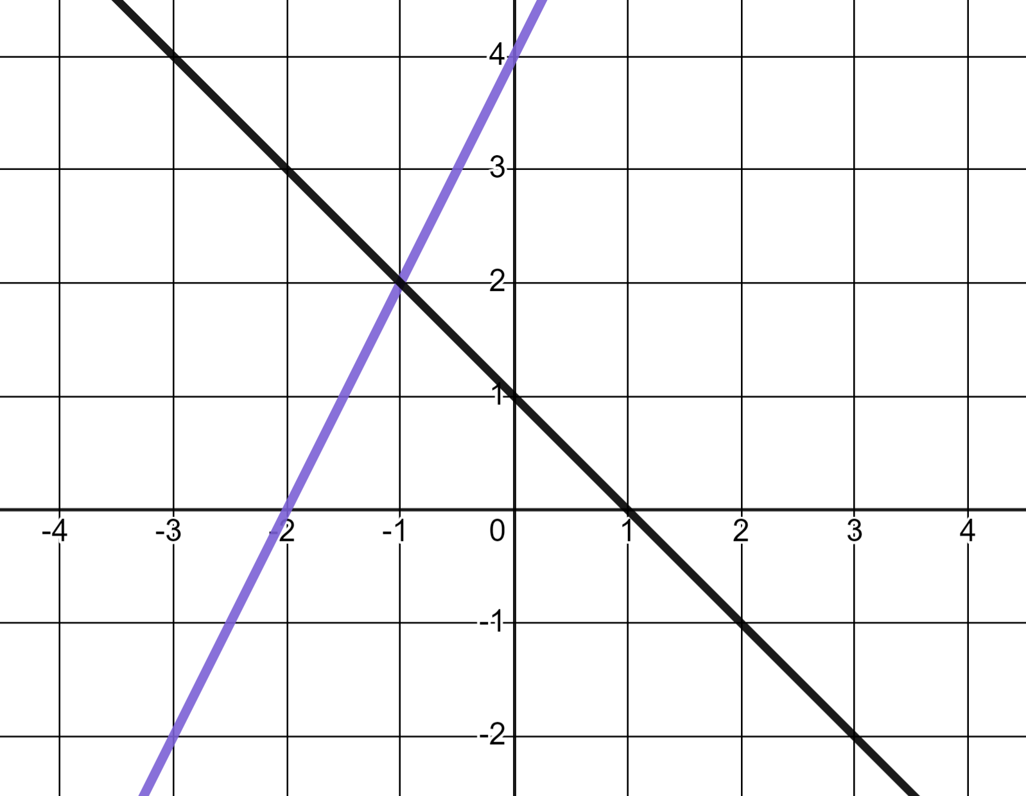
Points of intersection
The linear equations y = 2x + 4 and y = 1 − x intersect at the point with coordinates (−1, 2). What is the solution to 2x + 4 = 1 − x ?
y
x = 2
(−1, 2)
✖
x = 1
x
x = −1

Slide 15
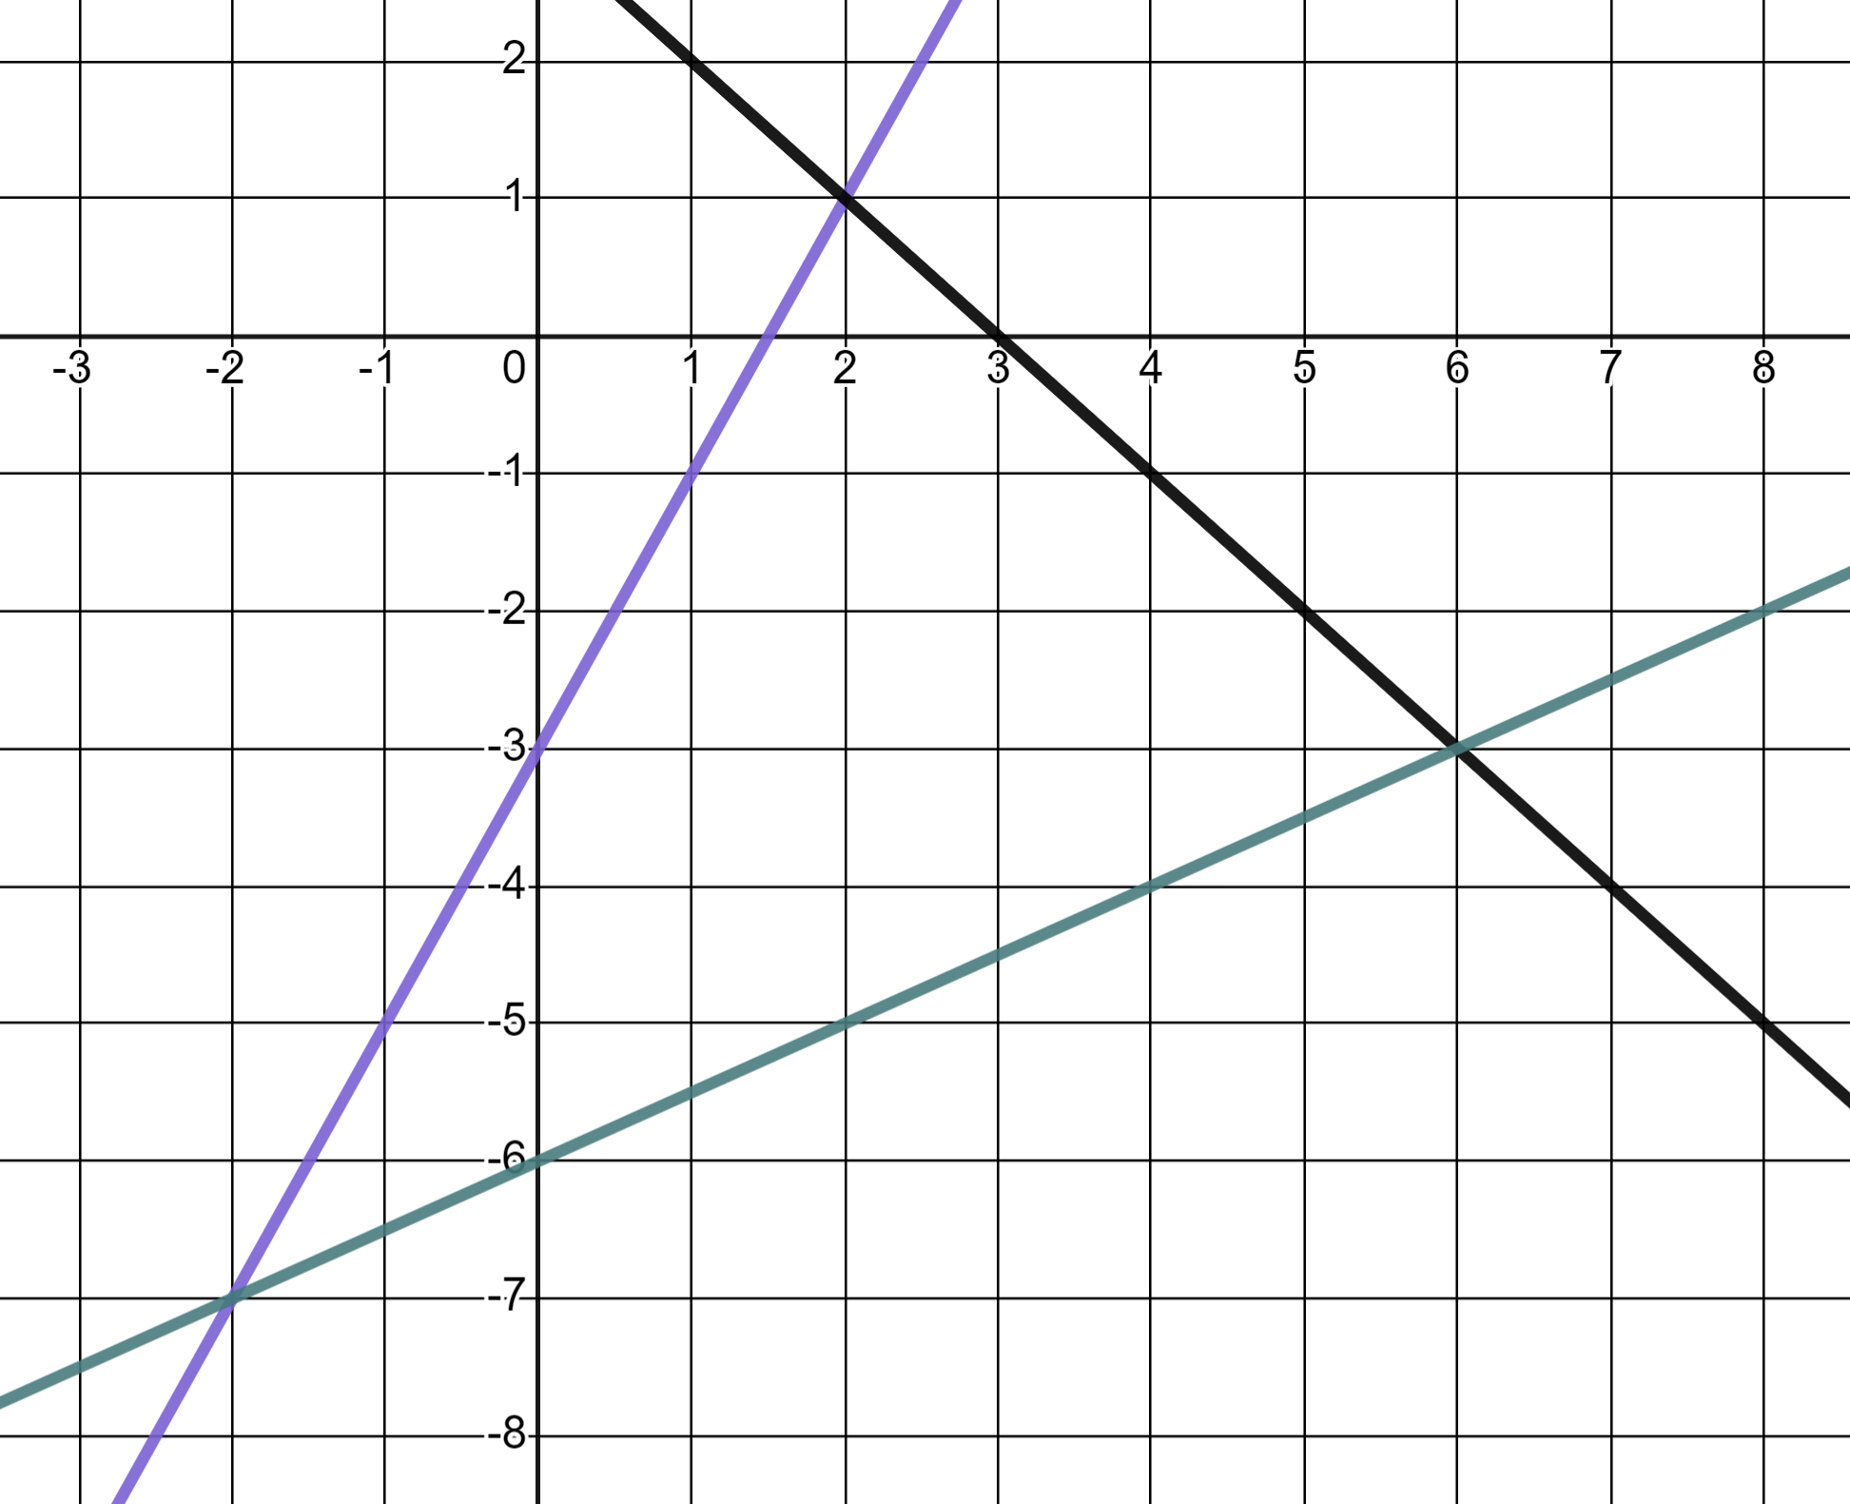
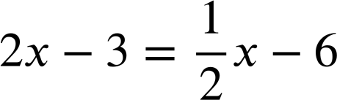
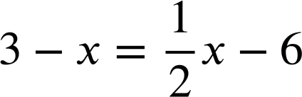
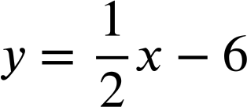
Points of intersection
1) Use the graphs to solve these equations.
y = 2x − 3
a)
2x − 3 = 3 − x
b)
c)
y = 3 − x

Slide 16
Points of intersection
2) Use the graphs to solve these pairs of simultaneous equations.
y = 2x − 3
a)
y = 2x − 3
y = 3 − x
b)
y = 2x − 3
c)
y = 3 − x
y = 3 − x

Slide 17
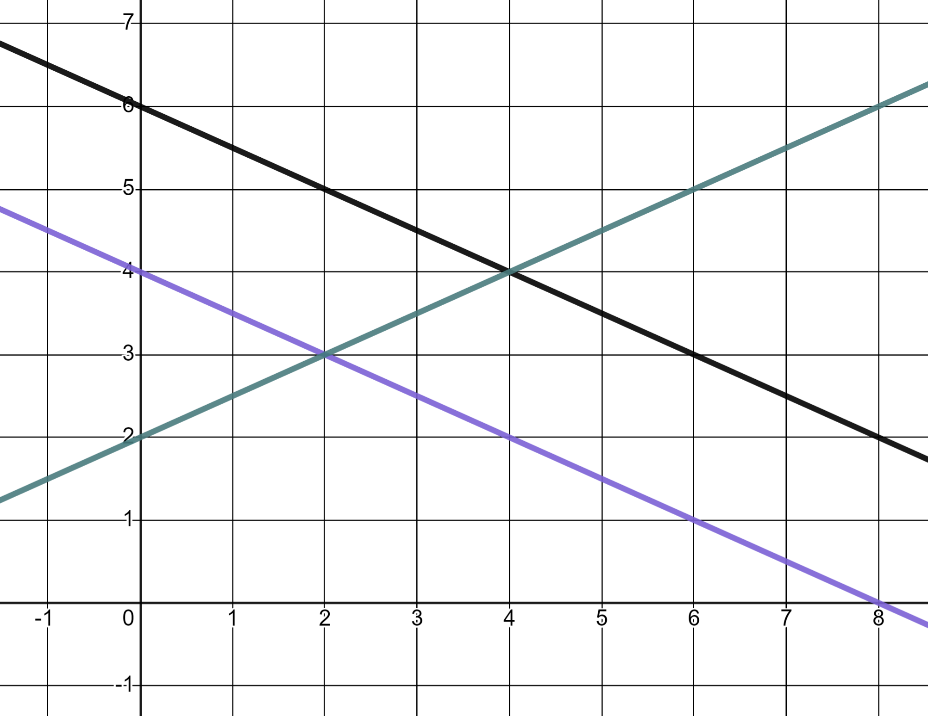
Points of intersection
3) a) Use the graph to identify two simultaneous equations which can be solved and find the solutions.
2y − x = 4
2x + 4y = 24
b) Explain why a third different pair of equations can not be found and solved using these particular lines.
2x + 4y = 16

Slide 18
Points of intersection
1) Use these graphs to solve the equations.
y = 2x − 3
a)
2x − 3 = 3 − x
✖
x = 2
b)
✖
x = −2
c)
y = 3 − x
x = 6
✖

Slide 19
Points of intersection
2) Use the graphs to solve these pairs of simultaneous equations.
y = 2x − 3
a)
y = 2x − 3
✖
(2, 1)
x = 2, y = 1
y = 3 − x
b)
y = 2x − 3
x = −2, y = −7
(6, −3)
✖
c)
y = 3 − x
y = 3 − x
x = 6, y = −3
✖
(−2, −7)

Slide 20
Points of intersection
3) a) Use the graph to identify two pairs of simultaneous equations which can be solved and find the solutions.
2y − x = 4
2x + 4y = 24
b) Explain why a third different pair of equations can not be found and solved using these particular lines.
2x + 4y = 16

Slide 21
Points of intersection
3) a) Use the graph to identify two pairs of simultaneous equations which can be solved and find the solutions.
2y − x = 4
2x + 4y = 24
✖
(4, 4)
One pair of simultaneous equations:
2x + 4y = 24
2y − x = 4
The solution:
x = 4, y = 4
2x + 4y = 16

Slide 22
Points of intersection
3) a) Use the graph to identify two pairs of simultaneous equations which can be solved and find the solutions.
2y − x = 4
2x + 4y = 24
Another pair of simultaneous equations:
✖
2x + 4y = 16
(2, 3)
2y − x = 4
The solution:
x = 2, y = 3
2x + 4y = 16

Slide 23
Points of intersection
3)
2y − x = 4
b) Explain why a third different pair of equations can not be found and solved using these particular lines.
2x + 4y = 24
Because they are linear equations there are no more intersections (therefore solutions) for the equations we have already highlighted.
The third pair of lines, 2x + 4y = 16 and 2x + 4y = 24 are parallel, therefore have no intersection, no solution.
2x + 4y = 16

Slide 24
Graphically solving two linear graphs that intersect
Points of intersection
Regions of a graph

Slide 25
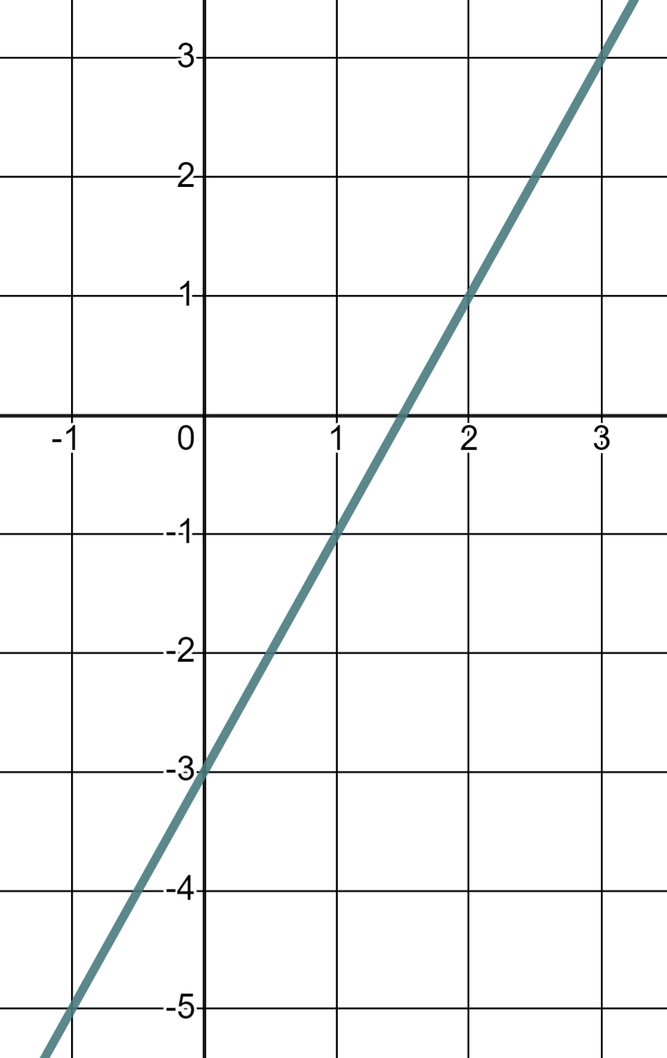
Regions of a graph
Why does this coordinate not satisfy the equation y = 2x − 3 ?
y
(1, 3)
✖
Because the y-coordinate is greater than the value of the expression 2x − 3 when x = 1
x
y is no longer equal to 2x − 3
y is greater than 2x − 3

Slide 26
Regions of a graph
y
We can therefore say this point has coordinates where y > 2x − 3
(1, 3)
✖
x
y is no longer equal to 2x − 3
y is greater than 2x − 3

Slide 27
Regions of a graph
Write down the coordinates of another point where y > 2x − 3
y
(1, 3)
✖
x

Slide 28
Regions of a graph
Write down the coordinates of another point where y > 2x − 3
y
✖
✖
✖
✖
You could have named any of these points. There were alot to choose from!
✖
✖
✖
✖
✖
✖
✖
You could also have chosen any one of the infinite non-integer value coordinates in this region!
✖
✖
✖
x
✖
✖
We call this a region. The region where y > 2x − 3
✖
✖
✖
✖

Slide 29
Regions of a graph
This point is in the region y > 2x − 3
y
For this pair of coordinates the value of the y-coordinate is greater than the value of the expression 2x − 3
(1, 3)
✖
x
What do you think we might say about the coordinates of this point?
✖
The value of the y-coordinate is less than the value of the expression 2x − 3

Slide 30
Regions of a graph
y
x
This point is in the region y < 2x − 3
✖
The value of the y-coordinate is less than the value of the expression 2x − 3

Slide 31
Regions of a graph
Write down the coordinates of another point where y < 2x − 3
y
You could have named any of these coordinates. There were alot to choose from!
✖
✖
You could also have chosen any one of the infinite non-integer value coordinates in this region!
✖
✖
x
✖
✖
✖
✖
✖
We call this the region where y < 2x − 3
✖
✖
✖
✖
✖
✖
✖
✖
✖
✖
✖

Slide 32
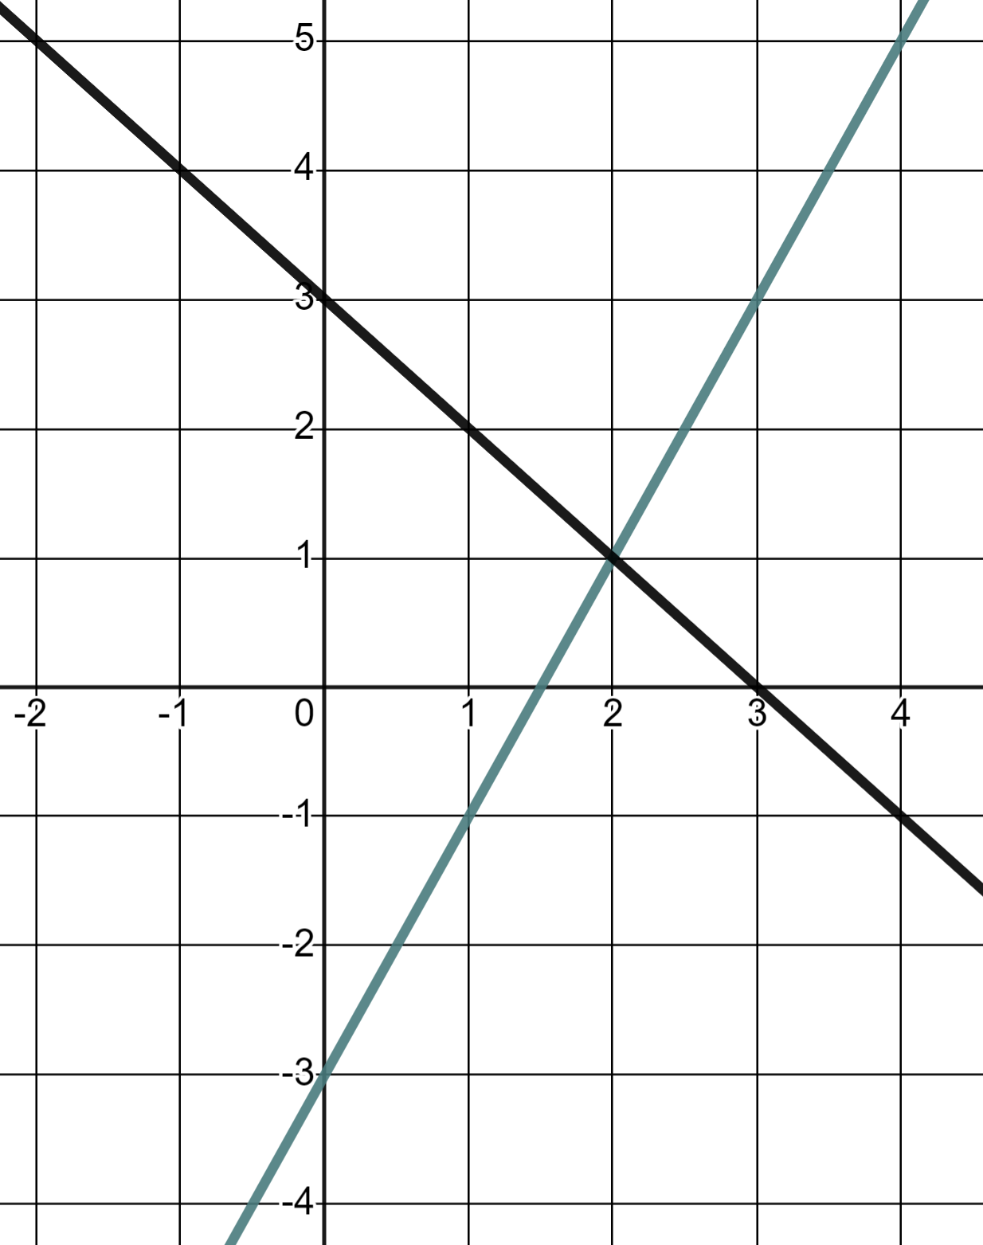
Regions of a graph
We can make more statements when we have two lines on the same graph.
y
y = 2x − 3
y = 3 − x
What do we know about this point?
✖
This point is in the region y > 2x − 3
x
…and it satisfies the equation y = 3 − x

Slide 33

Regions of a graph
Which point satisfies both y = 2x − 3 and y < 3 − x
y
y = 2x − 3
y = 3 − x
a
✖
Both coordinates a) and b) satisfied the equation y = 2x − 3 but b) was the only one of those two to be in the region y < 3 − x
x
✖
✖
b
c

Slide 34
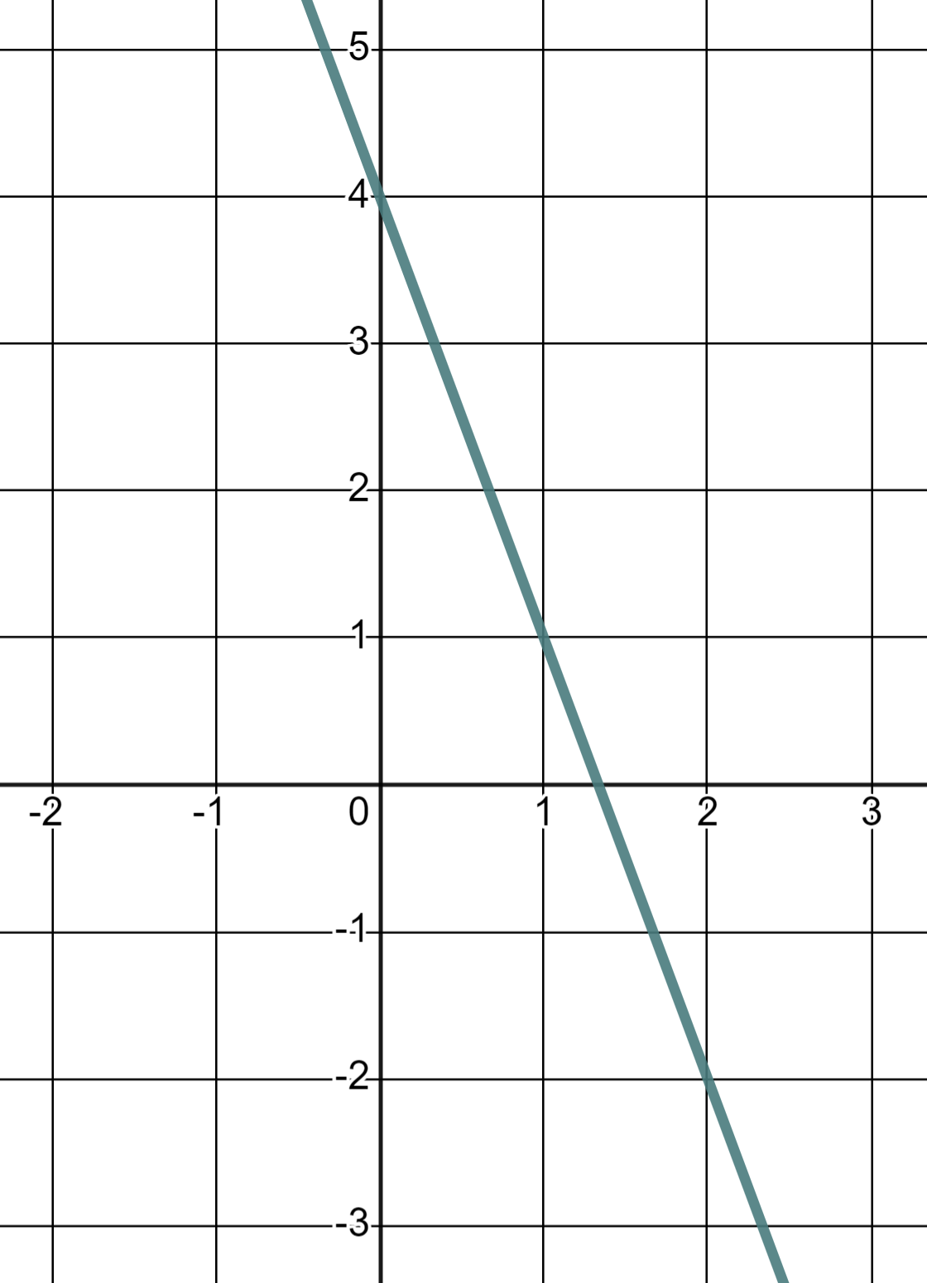
Regions of a graph
1) Here is the graph of y = 4 − 3x
y
a) Mark and label three points where y = 4 − 3x
b) Mark and label three points where y < 4 − 3x
x
c) Mark and label three points where y > 4 − 3x

Slide 35
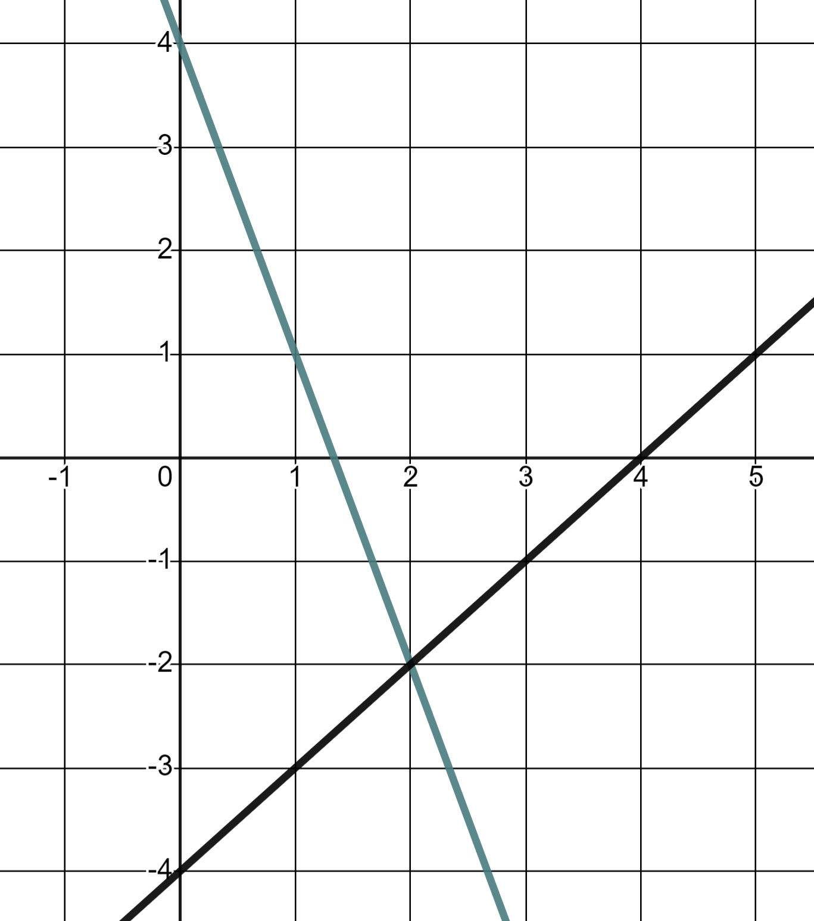
Regions of a graph
2) The lines y = 4 − 3x and y = x − 4
y
a) Mark and label three points where y = 4 − 3x and y > x − 4
b) Mark and label three points where y < 4 − 3x and y = x − 4
x
c) Mark and label the one point where y = 4 − 3x and y = x − 4

Slide 36
Regions of a graph
1) Here is the graph of y = 4 − 3x
y
a) Mark and label three points where y = 4 − 3x
b) Mark and label three points where y < 4 − 3x
x
c) Mark and label three points where y > 4 − 3x

Slide 37
Regions of a graph
1) Here is the graph of y = 4 − 3x
y
a) Mark and label three points where y = 4 − 3x
(0, 4)
✖
E.g.
These three coordinates all satisfy the equation y = 4 − 3x
You were not limited to integer value coordinates. Any three coordinates on this line is fine.
(1, 1)
✖
x
✖
(1.6, −0.8)

Slide 38
Regions of a graph
1) Here is the graph of y = 4 − 3x
y
(−2, 4)
b) Mark and label three points where y < 4 − 3x
✖
These three coordinates all in the region y < 4 − 3x
You were not limited to integer value coordinates. Any three coordinates in the region is fine.
x
(−1, −2)
✖
✖
(0.6, −1.3)

Slide 39
Regions of a graph
1) Here is the graph of y = 4 − 3x
y
(1, 5)
✖
c) Mark and label three points where y > 4 − 3x
(3, 0)
These three coordinates all in the region y > 4 − 3x
You were not limited to integer value coordinates. Any three coordinates in the region is fine.
✖
x
✖
(2.5, −1.5)

Slide 40
Regions of a graph
2) The lines y = 4 − 3x and y = x − 4
y
a) Mark and label three points where y = 4 − 3x and y > x − 4
b) Mark and label three points where y < 4 − 3x and y = x − 4
x
c) Mark and label the one point where y = 4 − 3x and y = x − 4

Slide 41
Regions of a graph
2) The lines y = 4 − 3x and y = x − 4
y
(0, 4)
✖
a) Mark and label three points where y = 4 − 3x and y > x − 4
These three coordinates all satisfy the equation y = 4 − 3x and the y-coordinates are all greater than x − 4
You were not limited to integer value coordinates. Any three coordinates on this line in this region are fine.
(1, 1)
✖
x
✖
(1.5, −0.5)

Slide 42
Regions of a graph
2) The lines y = 4 − 3x and y = x − 4
y
b) Mark three coordinates where y < 4 − 3x and y = x − 4
These three coordinates all satisfy the equation y = x − 4 and the y-coordinates are all less than 4 − 3x
You were not limited to integer value coordinates. Any three coordinates on this line in this region are fine.
x
(1.5, −2.5)
✖
✖
(1, −3)
✖
(0, −4)

Slide 43
Regions of a graph
2) The lines y = 4 − 3x and y = x − 4
y
There is only one coordinate that satisfies these conditions, that of the intersection.
x
✖
(2, −2)
c) Mark and label the one point where y = 4 − 3x and y = x − 4

Slide 44
Graphically solving two linear graphs that intersect
There are infinite points on a graph that satisfy a given linear relationship however, the point of intersection of two linear graphs only has one coordinate that satisfies both relationships and hence represents the solution to both those equations.
We can use inequalities to describe regions of a graph that are created by one or more equations of lines.

Slide 45

© Oak National Academy 2024.
Produced in partnership with Mathematics in Education and Industry.
Licensed on the Open Government Licence v3.0, except where otherwise stated. See Oak terms and conditions.

